Slide 1
Lecture 12 – Software Subsystem Architectural Design
COMP 3700: Modeling and Design
Chapters 13: Software Subsystem Architectural Design
Gomaa, 2011

Slide 2
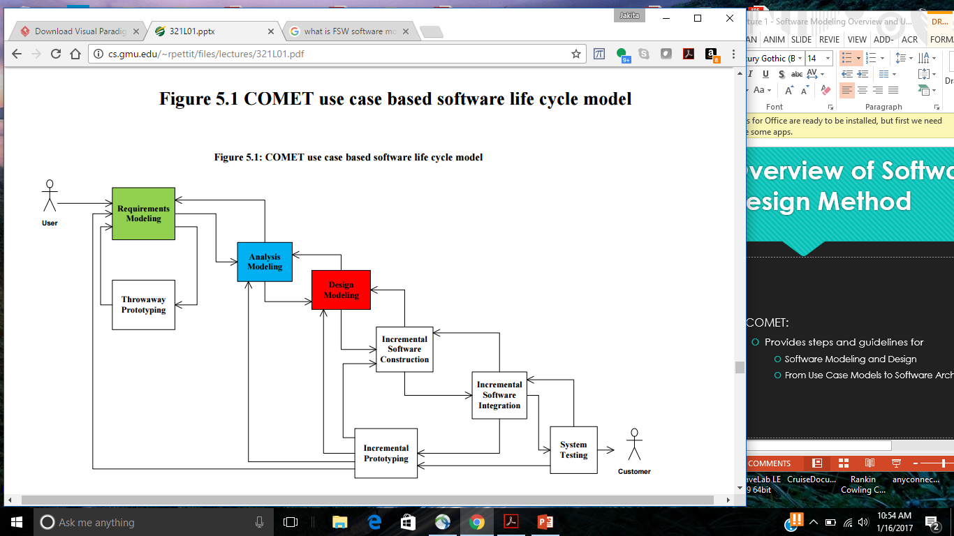
COMET Use Case Based Software Life Cycle Model
Develop Software Requirements Model
Develop Software Analysis Model
Develop Software Design Model
Design Overall Software Architecture (Chapter 12, 13)
Design Distributed Component-based Subsystems (Chapter 13, 15)
Structures Subsystems into Concurrent Tasks (Chapter 18)
Design Information Hiding Classes (Chapter 14)
Design Detailed Software Design
First, we must transition from Analysis to Design

Slide 3
Message Sequence Description
Supplementary documentation which is useful to provide with an interaction diagram
Developed as part of the dynamic model and describes how the analysis model objects participate in each use case as depicted on an interaction diagram
Narrative description describing:
What happens when each message arrives at a destination object depicted on an interaction diagram
Uses the message sequence numbers that appear on the interaction diagram
Describes the sequence of messages sent from source objects to destination objects and
Describes what each destination object does with a message it receives
Usually provides additional information not depicted on the object interaction diagram
Ex: which attributes of the object are referenced when an entity object is accessed
Examples of message descriptions are shown on page 144 in your text
Section 9.5.2 as a part of steps 3 and 4

Slide 4
Transition from Analysis to Design: Integration of Communication Diagrams
Used to determine overall structure of system
Merger of communication diagrams
Start with first communication diagram
Superimpose other communication diagrams
Add new objects and new message interactions from each subsequent diagram
Objects and interactions that appear on multiple diagrams are only shown once
Consider alternative scenarios for each use case
Integrated communication diagram
Shows all objects and their interactions

Slide 5
Design of Software Architecture
Software Architecture
Structure of software system
Software elements
Externally visible properties of elements
Relationships among elements
Develop initial software architecture
Synthesize from communication diagrams
Structure system into subsystems
Subsystems determined using structuring criteria
Use stereotypes for system structuring criteria (e.g., <<client>>, <<service>>, etc.)
Depict subsystems on subsystem communication diagrams

Slide 6
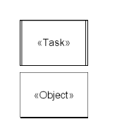
Active and Passive Objects
Objects may be active or pasisive
Active object
Concurrent task or component
Has thread of control
Passive object
a.k.a. Information Hiding Object
Has no thread of control
Operations of passive object are executed by task

Slide 7
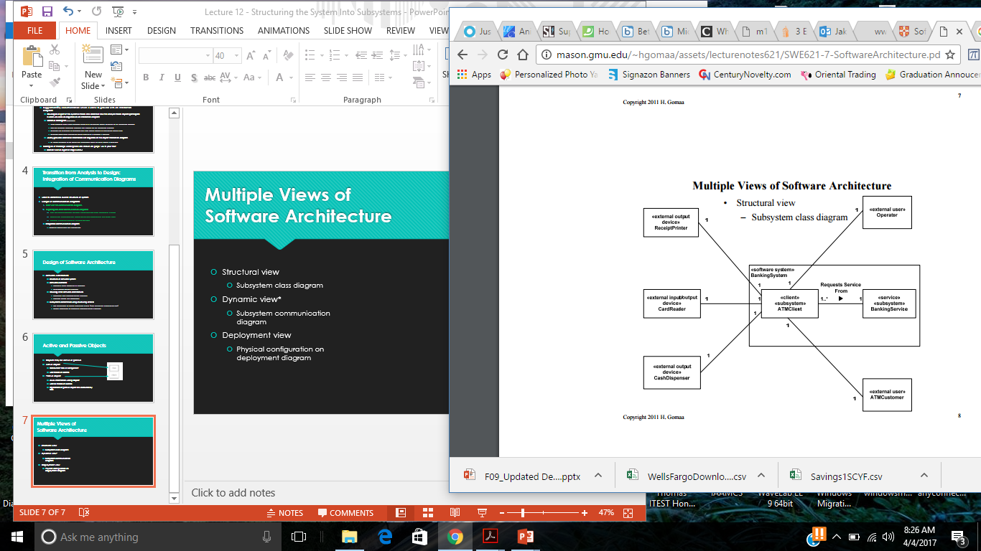
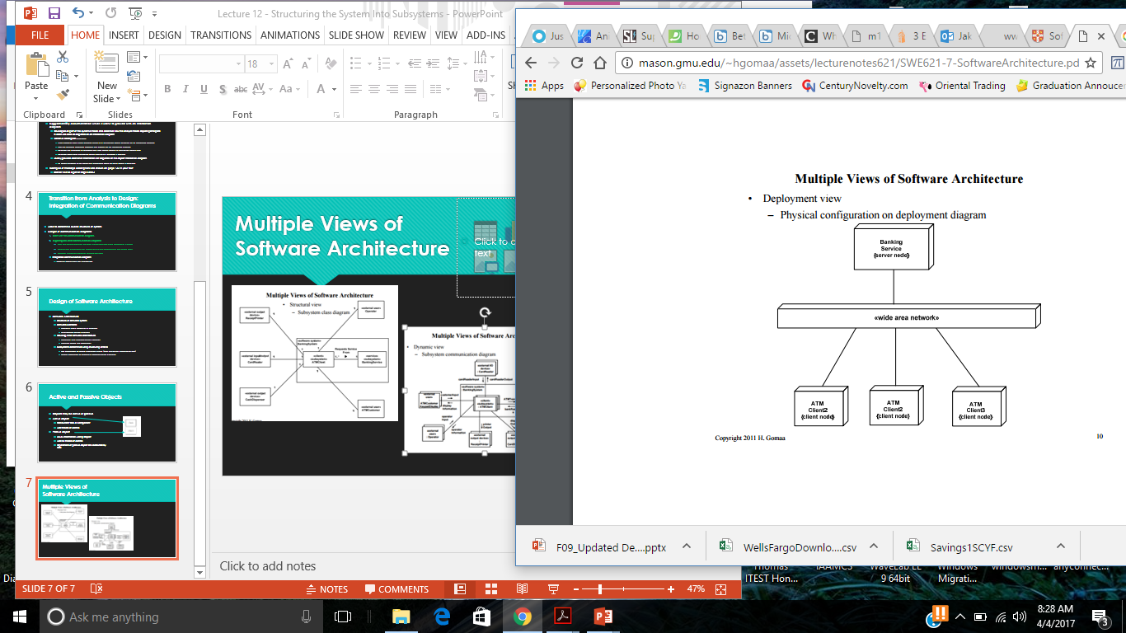
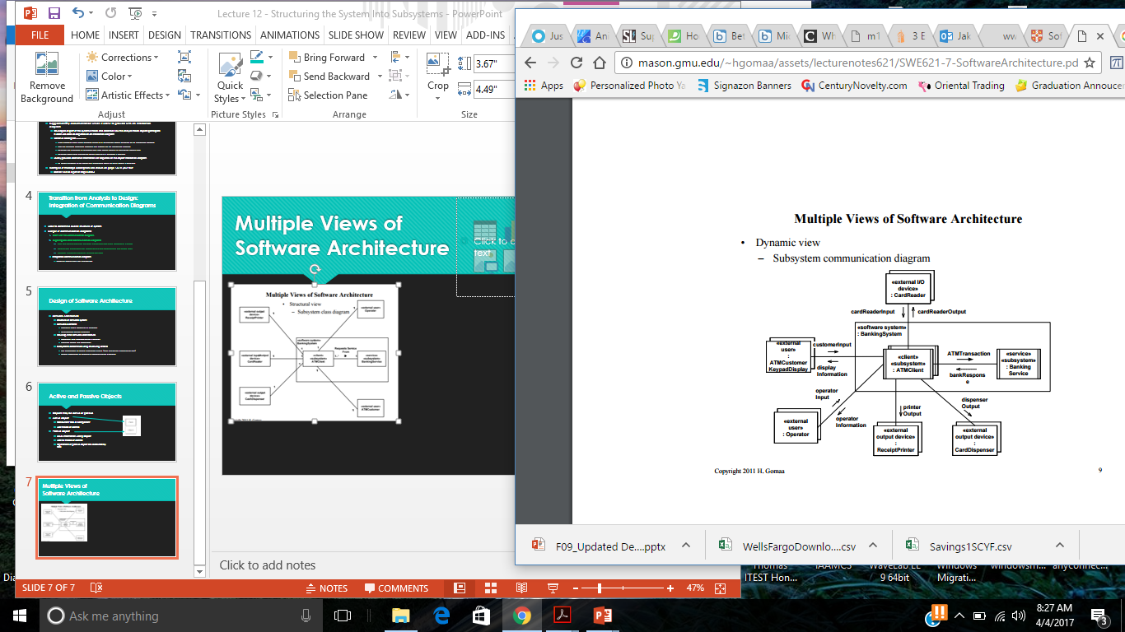
Multiple Views of Software Architecture
We will focus here

Slide 8
Design of Software Architecture
Software Architecture
Define overall structure of system
Component interfaces and interconnections
Separately from component internals
Each subsystem performs a major service
Contains highly coupled objects
Relatively independent of other subsystems
May be decomposed further into smaller subsystems
Subsystem is aggregate or composite object
Candidates for subsystem
Objects that participate in the same use case

Slide 9
Separation of Subsystem Concerns
Aggregate/composite object
Objects that are part of aggregate/composite object
Structure in same subsystem (e.g., Figure 13.3)
Interface to external objects
External real-world object should interface into 1 subsystem (e.g., Figure 13.7)
Scope of Control
Control object & objects it controls are in same subsystem (e.g., Figure 13.2)
Geographical location
Objects at different locations are in separate subsystems (e.g., Figure 13.5)
Clients and Services
Place in separate subsystems (e.g., 13.5, 13.7)
User Interaction
Separate client subsystem (e.g., 13.5, 13.6)

Slide 10
Subsystem Structuring Criteria
Client - <<client>>
Requestor of one or more services
User Interaction - <<external user>>
Collection of objects supporting needs of user
Service - <<service>>
Provides service for client subsystems
Control – could be several different stereotypes
Subsystem controls given aspect of system
Coordinator – could be several different sterotypes
Coordinates several control subsystems
Input/Output <<external I/O device>>, <<external output device>>
Performs I/O operations for other subsystems

Slide 11
Steps for Creating Initial Concurrent Communication Diagram
Start with conceptual static model and software context class diagram
Conceptual static model shows the separation of the hardware/software of the system
Software context class diagram depicts the external classes of the system with the hardware/software depicted as an aggregate class (black box)
Remove the actors from the software context class diagram
Depict the aggregated hardware/software class in the software context class diagram as a white box, showing the internal subsystems
Identify whether subsystems are <<service>> or <<client>> and mark them all as <<subsystems>>
Two stereotypes
Be sure that the white box system has a name and give it the stereotype of <<software system>>
Identify and represent the whitebox subsystems as active or passive
Change the verbs on the lines of on the modified software context class diagram to describe the specific information being passed (e.g., customer input, display information, printer output, etc.) – these are the messages
Denote (using arrows) whether the messages are asynchronous or synchronous

Slide 12
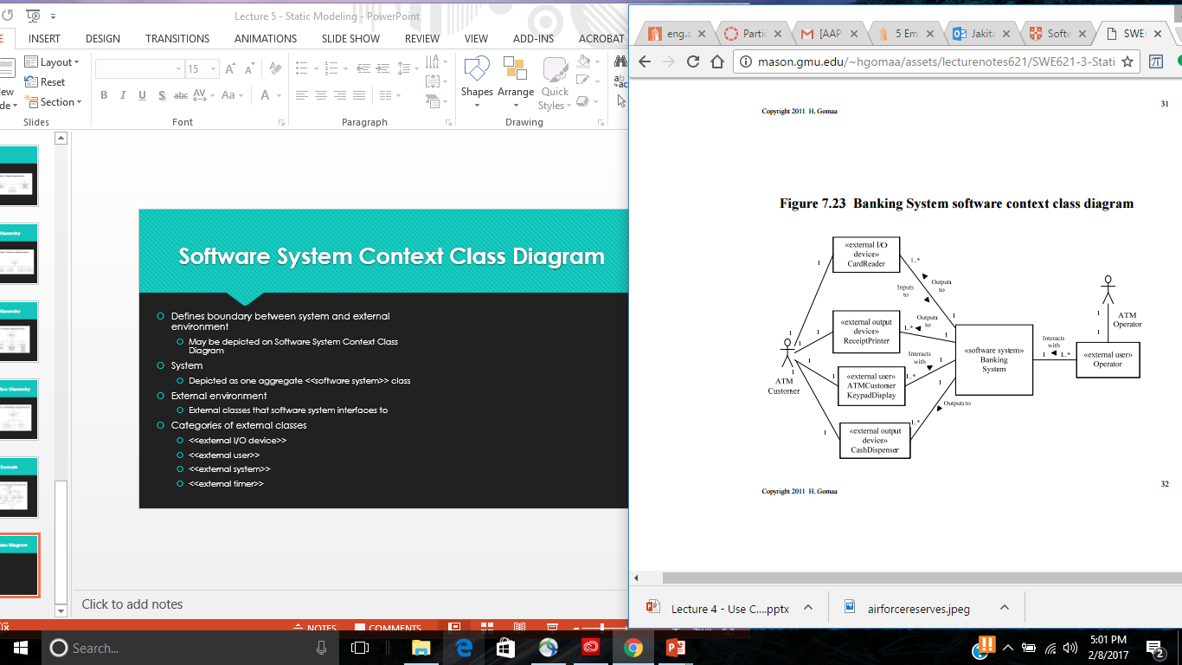
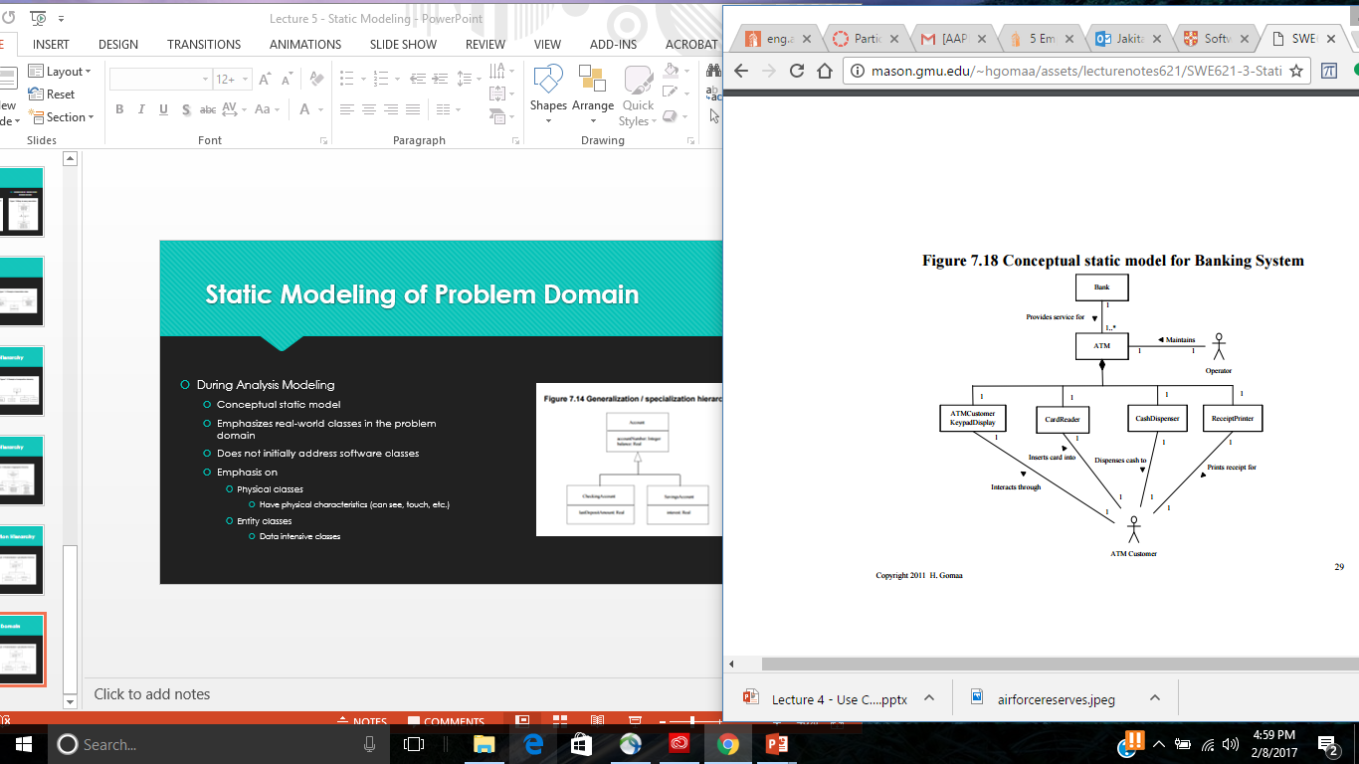
Step 1: Start with conceptual static model and software context class diagram

Slide 13
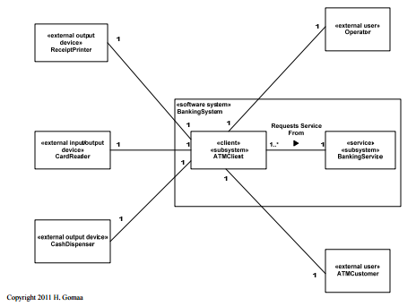
Steps 2 and 3: Remove the actors from the software context class diagram and deaggregate the hardware/software system blackbox into a white box

Slide 14
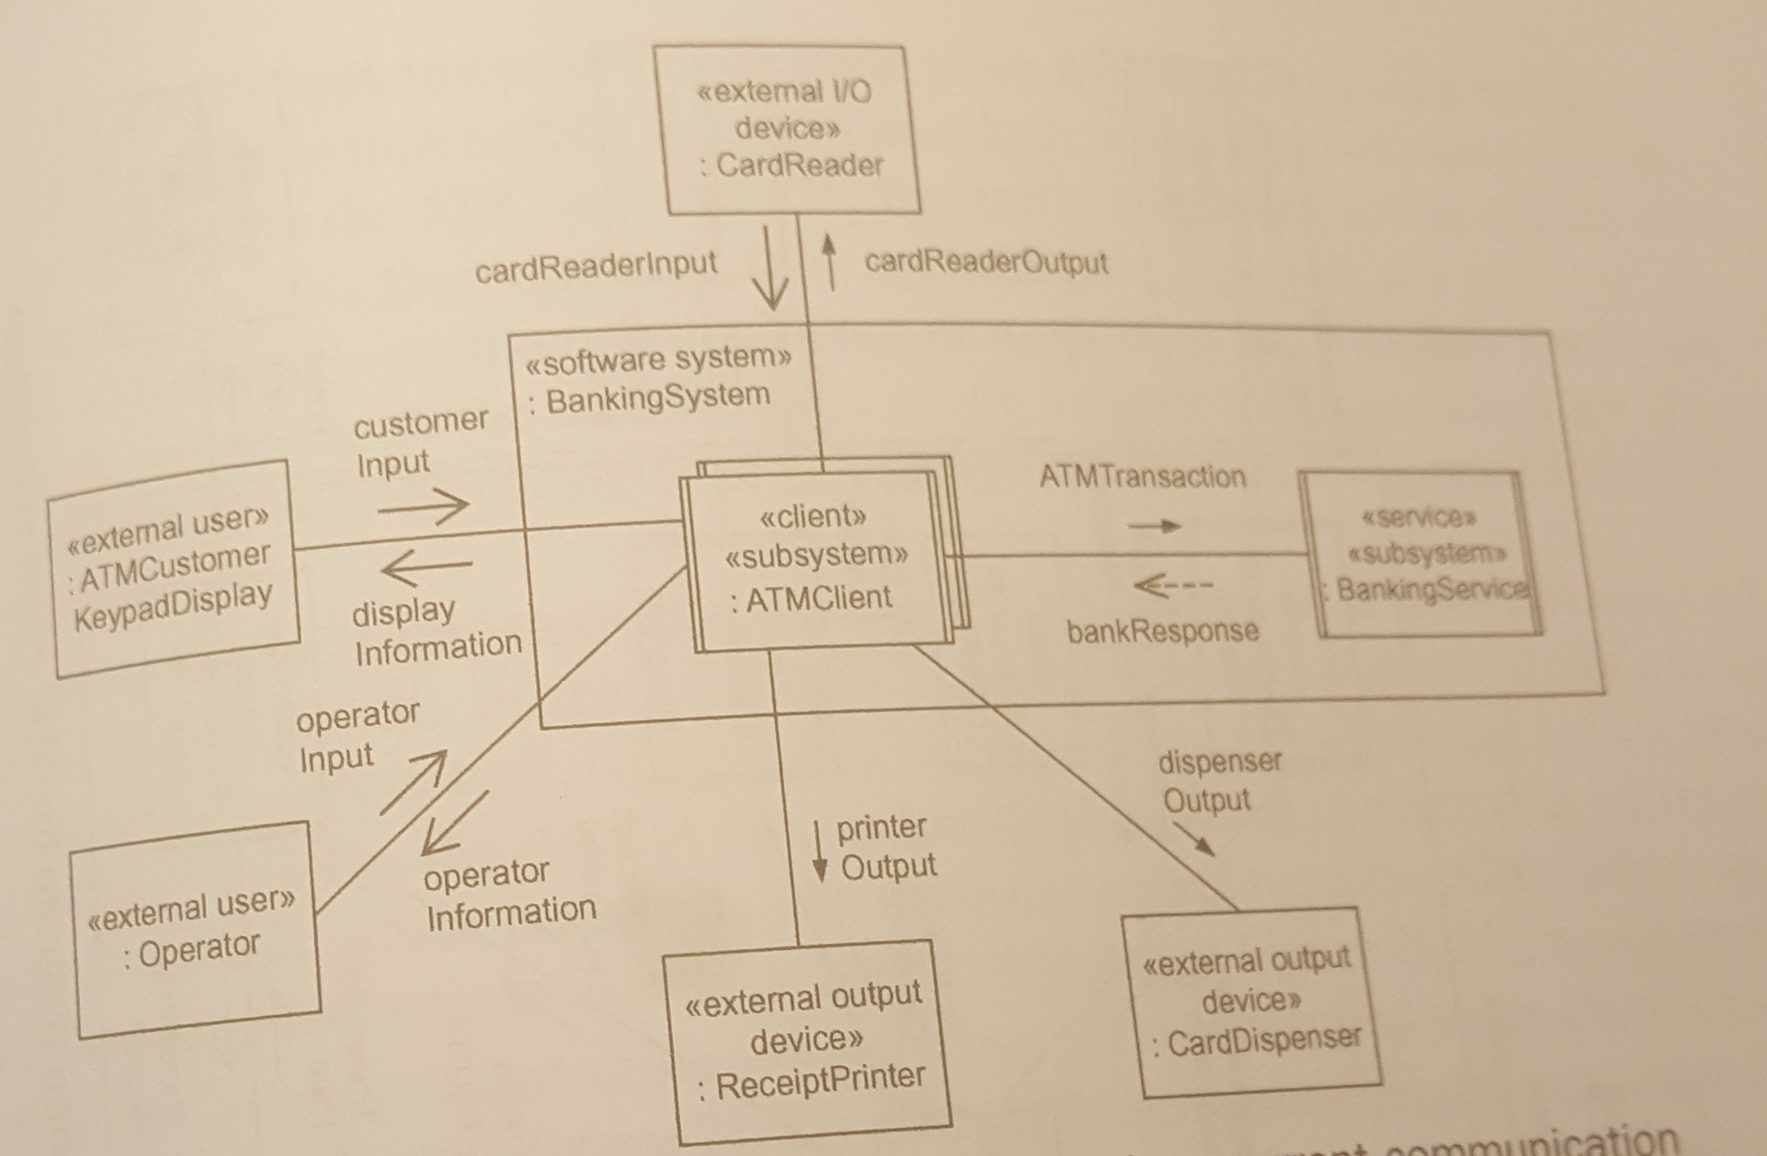
Steps 4 - 6
Identify and represent the whitebox subsystems as active or passive
Change the verbs on the lines of on the modified software context class diagram to describe the specific information being passed (e.g., customer input, display information, printer output, etc.) – these are the messages
Denote (using arrows) whether the messages are asynchronous or synchronous

